Slide 1
MIT Strategic Plan 2012-20

Slide 2
MIT Vision and purpose
Vision
MIT will be widely recognised as the leading ITP in New Zealand. (old)
Getting people into great jobs. (Current)
Purpose
Transforming lives, organisations and communities through learning.

Slide 3
Mission
Mission
To deliver vocationally focussed tertiary education, research and technology transfer that ensures Auckland’s economy, graduates, employers and communities have the capability and skills to achieve their potential.
MIT recognises that it has a special obligation to serve the people, communities and employers of Counties Manukau and that achieving significantly improved tertiary education outcomes in this sub-region is critical to both our mission and to the future economic and social prosperity of the nation.

Slide 4
values
WE ARE REAL
We are genuine, honest and down to earth.
MANAAKITANGA
We care for others to nurture achievement.
WE ARE CONNECTED
We are well connected, open and approachable.
WE ARE EXCELLENT
We get great results and celebrate success.

Slide 5
Goals
We will measure ourselves against five key goals which are:
1. Improved Employability and Progression;
2. Increased Participation;
3. Improved Success and Retention;
4. Enhanced Experience and Satisfaction; and
5. Increased Consultancy.

Slide 6
Measurement
Of these five goals the goal of “Improved Employability and Progression” will be an area of particular focus for the duration of the period covered by this plan.
In 2020 we will know we have succeeded if we have:
90% of graduates in employment or higher study within 6 months;
12,000 Domestic EFTS and 1,000 International EFTS;
85% Course Completion and 5,000 Qualification Completions at Level 4 and above;
Student Satisfaction of 8.5 out of 10; and
$20m per annum of consultancy income.

Slide 7
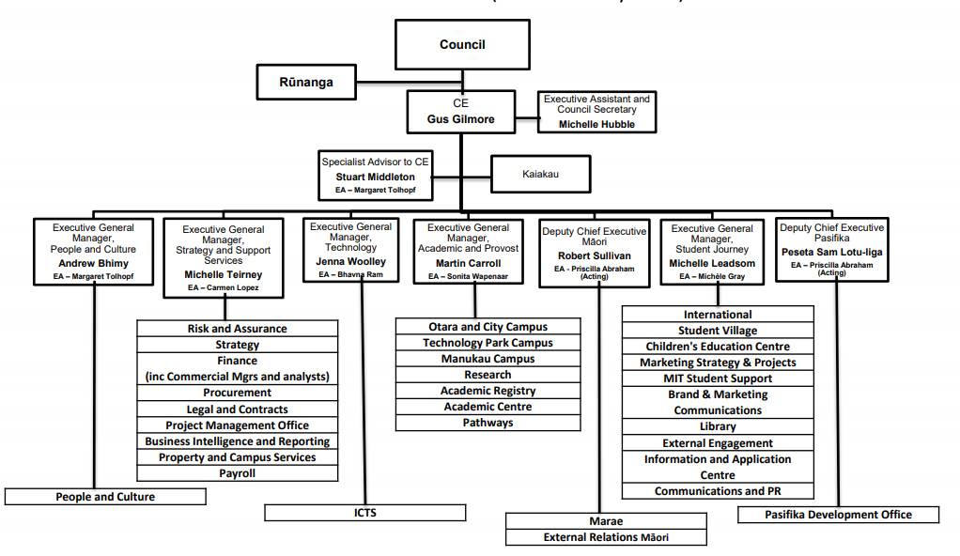
MIT organisational Structure (February 2018)

